Slide 1

Damages in 657
By David Callaway

Slide 2
Objectives
Diving into damages and data in 657
Establishing and defining our damages
Discuss improvements and possible solutions

Slide 3
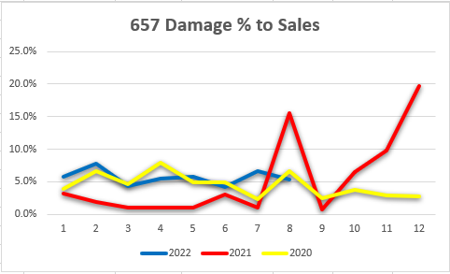
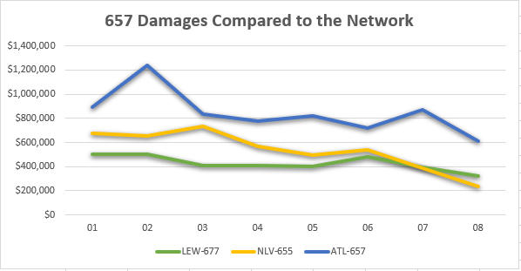
Where we stand today

Slide 4
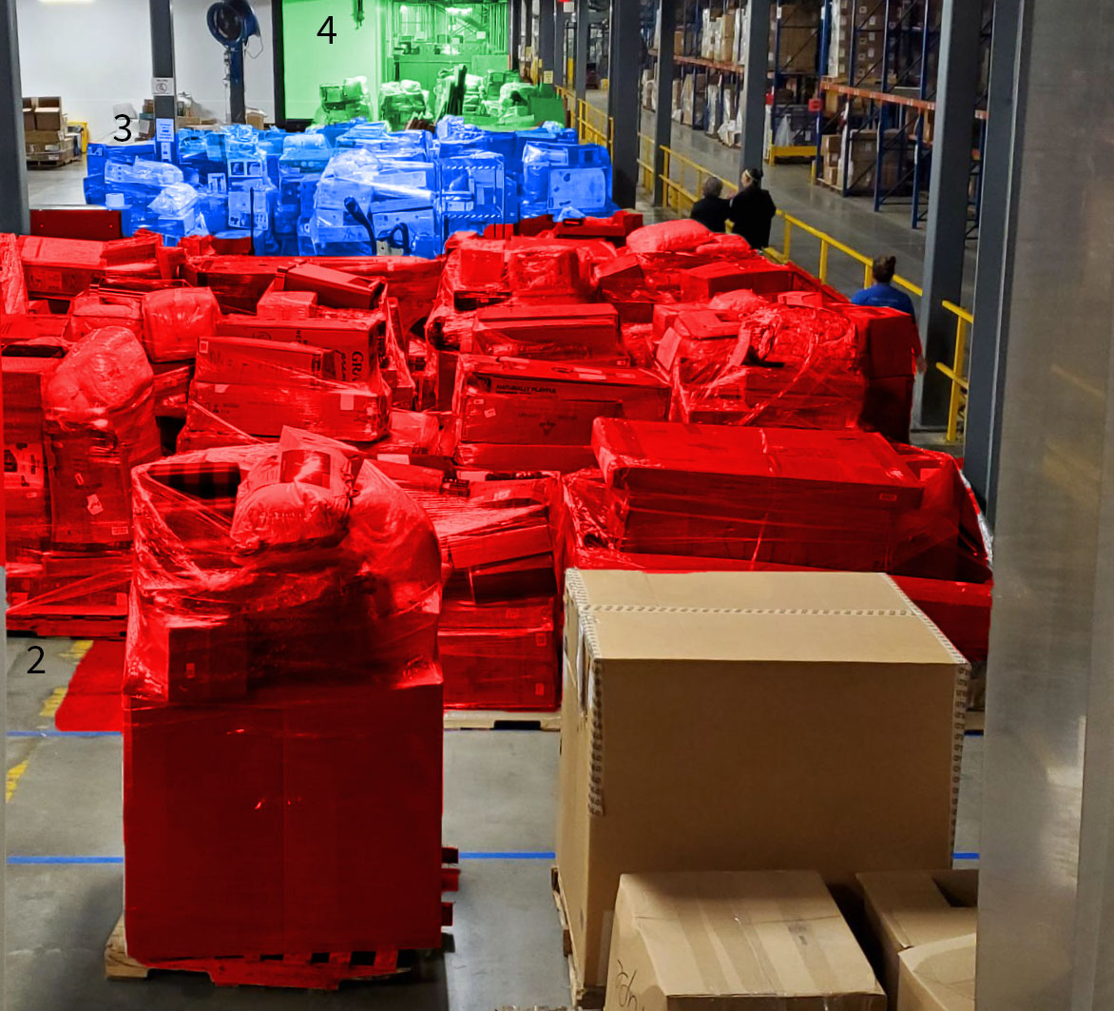
Realizing our damages
$273,431 average weekly cost

Slide 5
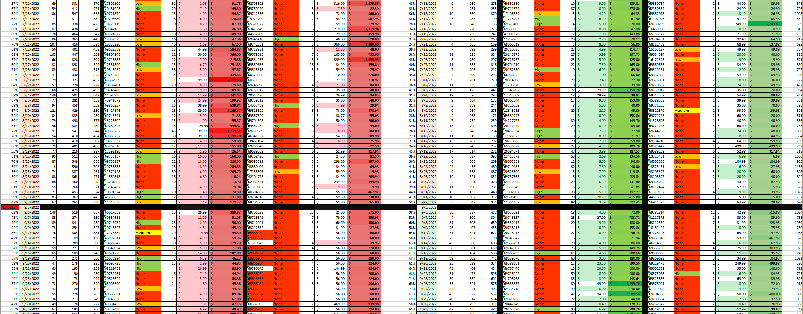
Understanding our damages
Daily and monthly summaries

Slide 6
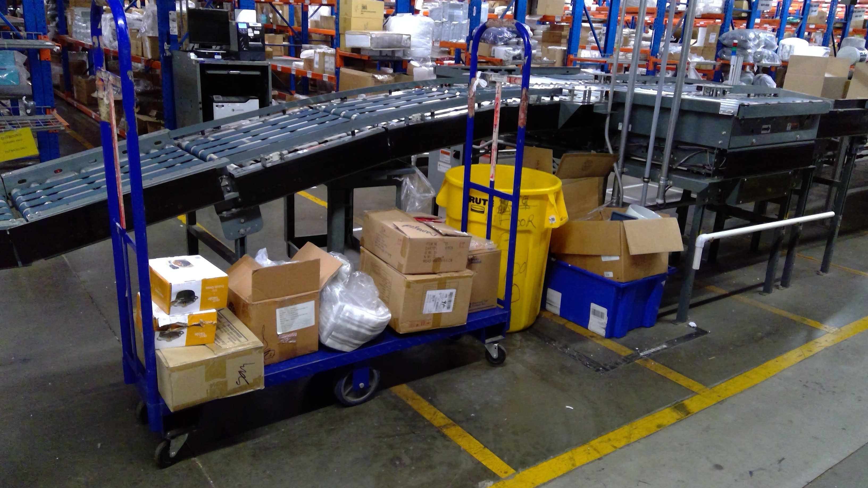
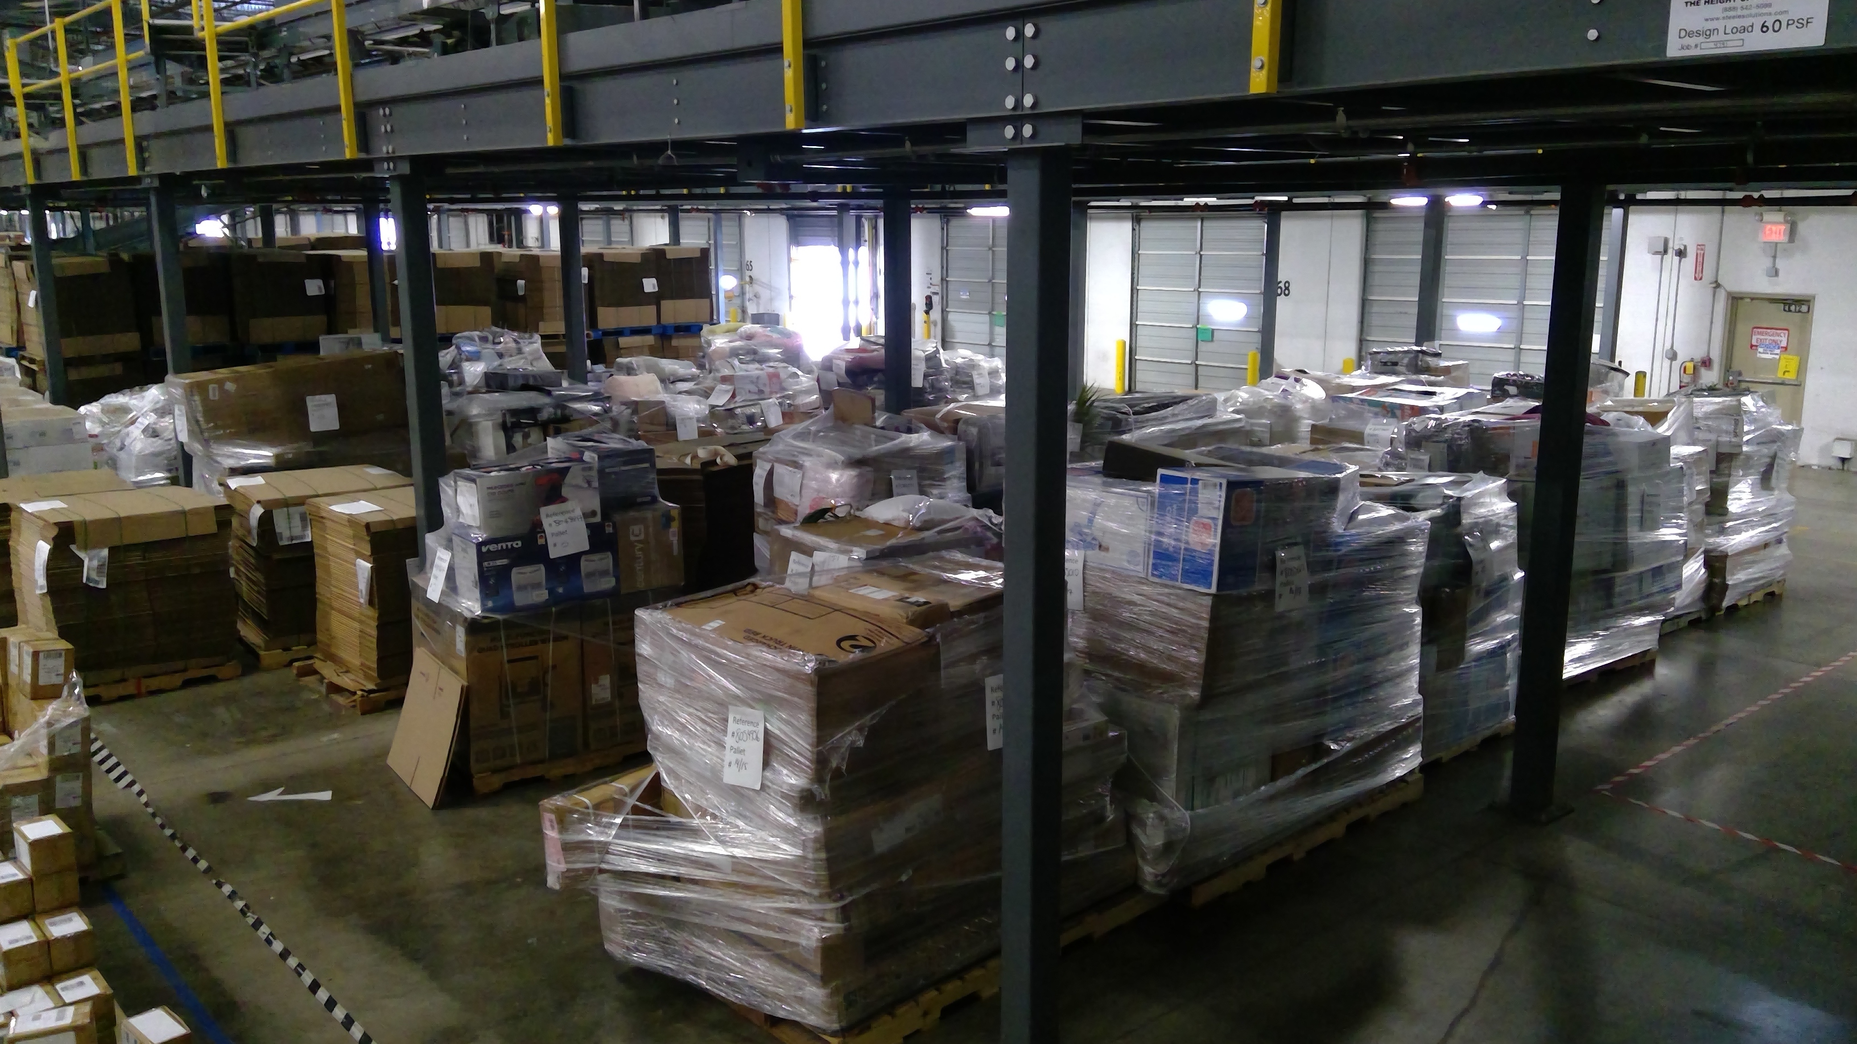
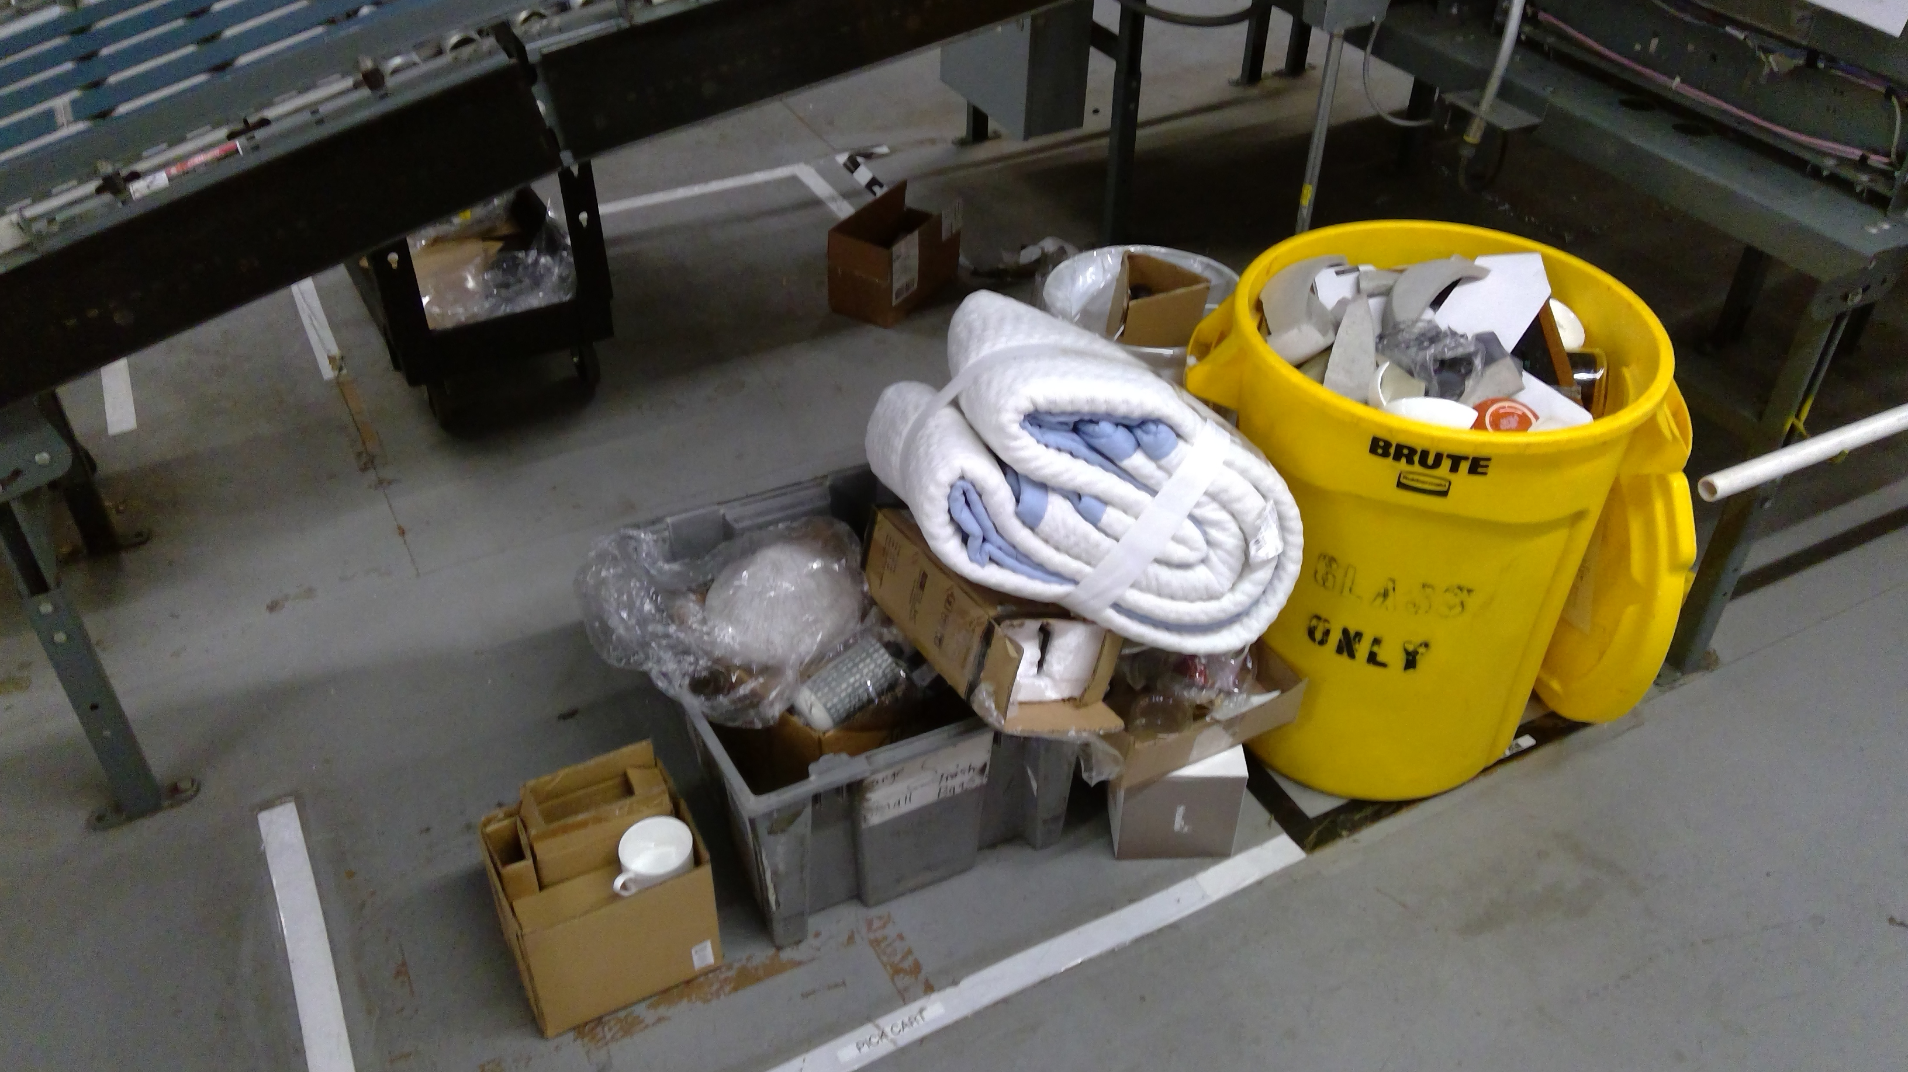
What we can do
Set standard for what is “Damaged”
Crinkle Wrinkle Dent
Promote higher standard of “Pick Ready”

Slide 7
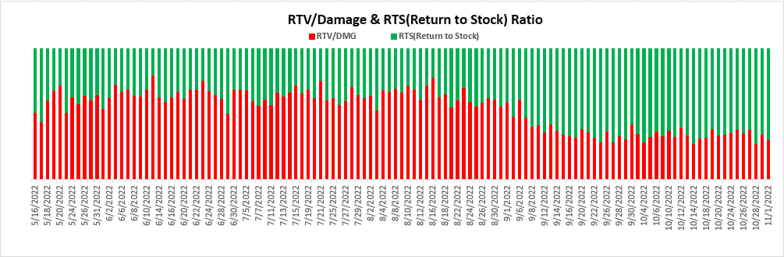

Slide 8
Promoting excellence and reducing damages go hand in hand

